Slide 1
Temperature resistant Lan Hubs
5- 8 Ports

Slide 2
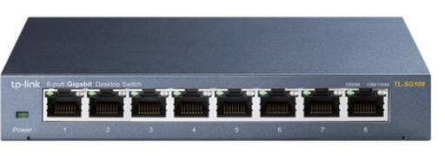
TP-LINK TL-SG108 스위치허브
10/100/1000Mbps, RJ-45, 출력 : 5VDC / 0.6A, 온도:0~60도
https://www.coupang.com/vp/products/1130115770?itemId=2097812305&vendorItemId=70096698992&src=1032034&spec=10305197&addtag=400&ctag=1130115770&lptag=I2097812305&itime=20240104113830&pageType=PRODUCT&pageValue=1130115770&wPcid=16879384198458490507261&wRef=prod.danawa.com&wTime=20240104113830&redirect=landing&mcid=15280eb7a58f4b63a84bec9e2cb8bcf7&isAddedCart=

Slide 3
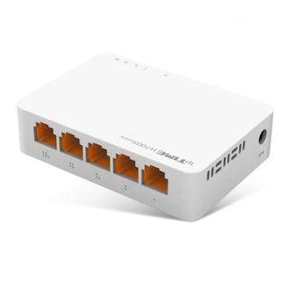
아이피타임 EFM ipTIME H7005mini 스위칭허브 5포트 기가비트
10/100/1000Mbps, 93x65x24mm, 0~60도, RJ-45,
https://www.coupang.com/vp/products/7542599040?itemId=19831839710&vendorItemId=86933563398&src=1032034&spec=10305199&addtag=400&ctag=7542599040&lptag=P7542599040&itime=20240104114029&pageType=PRODUCT&pageValue=7542599040&wPcid=16879384198458490507261&wRef=prod.danawa.com&wTime=20240104114029&redirect=landing&mcid=6253e7f97ebb4e4e9fe9d6adc17bddce&isAddedCart==

Slide 4
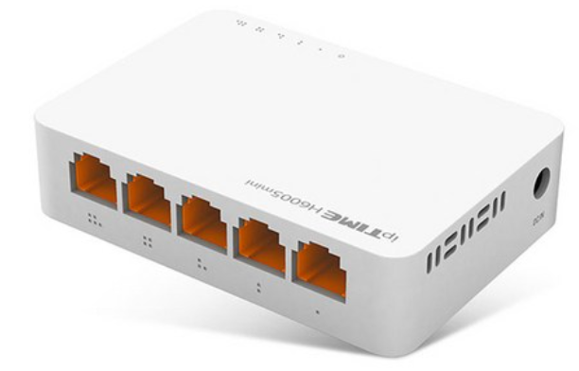
아이피타임 EFM ipTIME H7005mini 스위칭허브 5포트 기가비트
10/100/1000Mbps, 93x65x24mm, 0~60도, RJ-45, 5V DC
https://www.coupang.com/vp/products/328591616?vendorItemId=5517287441&sourceType=SDP_ALSO_VIEWED&pickType=COU_PICK&searchId=e9056b685cd446d3beb3f9460b501d36&rmdId=e9056b685cd446d3beb3f9460b501d36&eventLabel=recommendation_widget_pc_sdp_001&platform=web&rmdABTestInfo=49642:D&rmdValue=p7542599040:vt-coupangchoice-1.0.0:p328591616&isAddedCart=

Slide 5
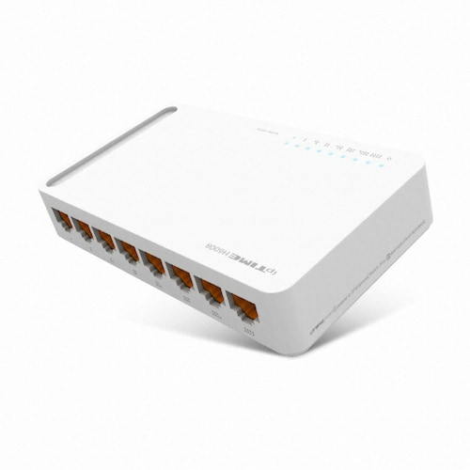
ipTIME 8포트 기가비트 스위치허브
섭씨 0 - 60도, 4.5kW, 온도: 0~60도
204 x 156 x 72 mm / 304g
https://www.coupang.com/vp/products/6959811688?itemId=16939146952&vendorItemId=84116717183&src=1032034&spec=10305199&addtag=400&ctag=6959811688&lptag=I16939146952&itime=20240104114423&pageType=PRODUCT&pageValue=6959811688&wPcid=16879384198458490507261&wRef=prod.danawa.com&wTime=20240104114423&redirect=landing&mcid=e888e88ebcfb402fb12d1915cc92e4be&isAddedCart=

Slide 6
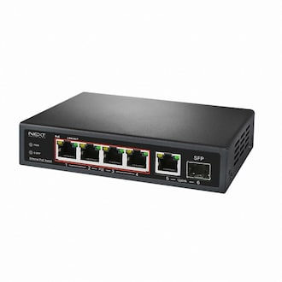
이지넷유비쿼터스 넥스트 NEXT-POE7006SFP-TP PoE 스위치허브
온도: -40~80도, 65W 대용량 지원
정격전압, 소비전력:DC 12~52V
https://www.coupang.com/vp/products/1968914712?itemId=3348435832&vendorItemId=3482764134&src=1032034&spec=10305199&addtag=400&ctag=1968914712&lptag=P1968914712&itime=20240104131950&pageType=PRODUCT&pageValue=1968914712&wPcid=16879384198458490507261&wRef=prod.danawa.com&wTime=20240104131950&redirect=landing&mcid=6c09c59100934f3689d5fce008a9969b&isAddedCart=

Slide 7
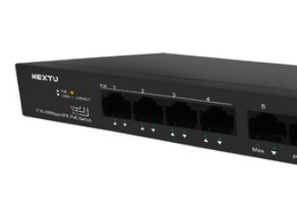
NEXT-POE606F 4포트 10/100M POE+ 업링크 2포트 TP 스위칭허브/CCTV 모드 지원
온도: -40~85도, 60W, 36000원
전원:DC 12~48V
https://www.coupang.com/vp/products/65628432?itemId=221414834&vendorItemId=3544976019&src=1032034&spec=10305199&addtag=400&ctag=65628432&lptag=P65628432&itime=20240104133042&pageType=PRODUCT&pageValue=65628432&wPcid=16879384198458490507261&wRef=prod.danawa.com&wTime=20240104133042&redirect=landing&mcid=487c8059487e49879ebed2a9832e0de1&isAddedCart=

Slide 8
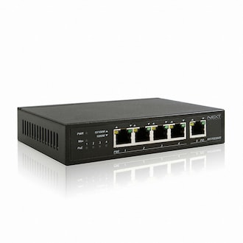
이지넷유비쿼터스 넥스트 NEXT-POE3004PD PoE+ 스위치허브
온도: -40~85도, 60W, 140x92.528mm
전원:DC ~55V
작동 온도: -40~70
https://prod.danawa.com/info/?pcode=3248134&keyword=%EB%84%A5%EC%8A%A4%ED%8A%B8+NEXT-POE&cate=11230207

Slide 9
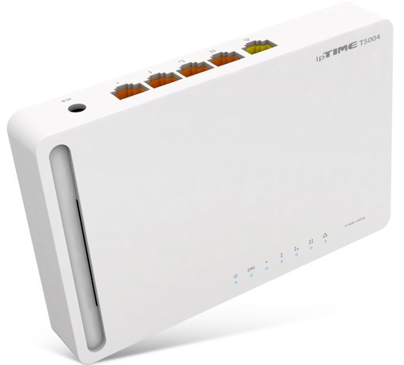
이지넷유비쿼터스 넥스트 NEXT-POE3004PD PoE+ 스위치허브
온도: -40~85도, 60W, 140x92.528mm
전원:DC ~55V
작동 온도: -40 °C ~85 °C
https://prod.danawa.com/info/?pcode=3248134&keyword=%EB%84%A5%EC%8A%A4%ED%8A%B8+NEXT-POE&cate=11230207

